Slide 1
Analysis of Ship Times and Rebuy Rates
Data Science Exploration by Ryan Mersereau

Slide 2
What was our end goal?
To determine customer rebuy rate based on some factor
Specifically, we wanted to look at Delivery Time of orders
Initial assumptions: Shorter delivery time of packages would lead to higher rebuy rates, on average.

Slide 3
Brainstorming and Obtaining data
What do we need and how do we get it?
What do we need? (What columns would fill our data table?)
Order number
Order ship & arrival date
Customer GUID
Time to delivery
Number of times ordered for each customer
Ship state/ country
Notes:
-Didn’t end up using ship state, could in the future

Slide 4
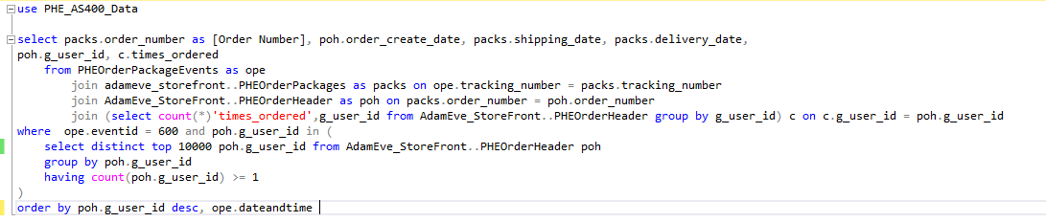
How did we get this data?
Using the Adam&Eve Storefront database and AS400 database accessed through SQL
We used DHL Order data from AS400
Vadim showed us where useful data tables were to get what we needed
Thomas helped us complete a SQL query to extract this data (below)

Slide 5
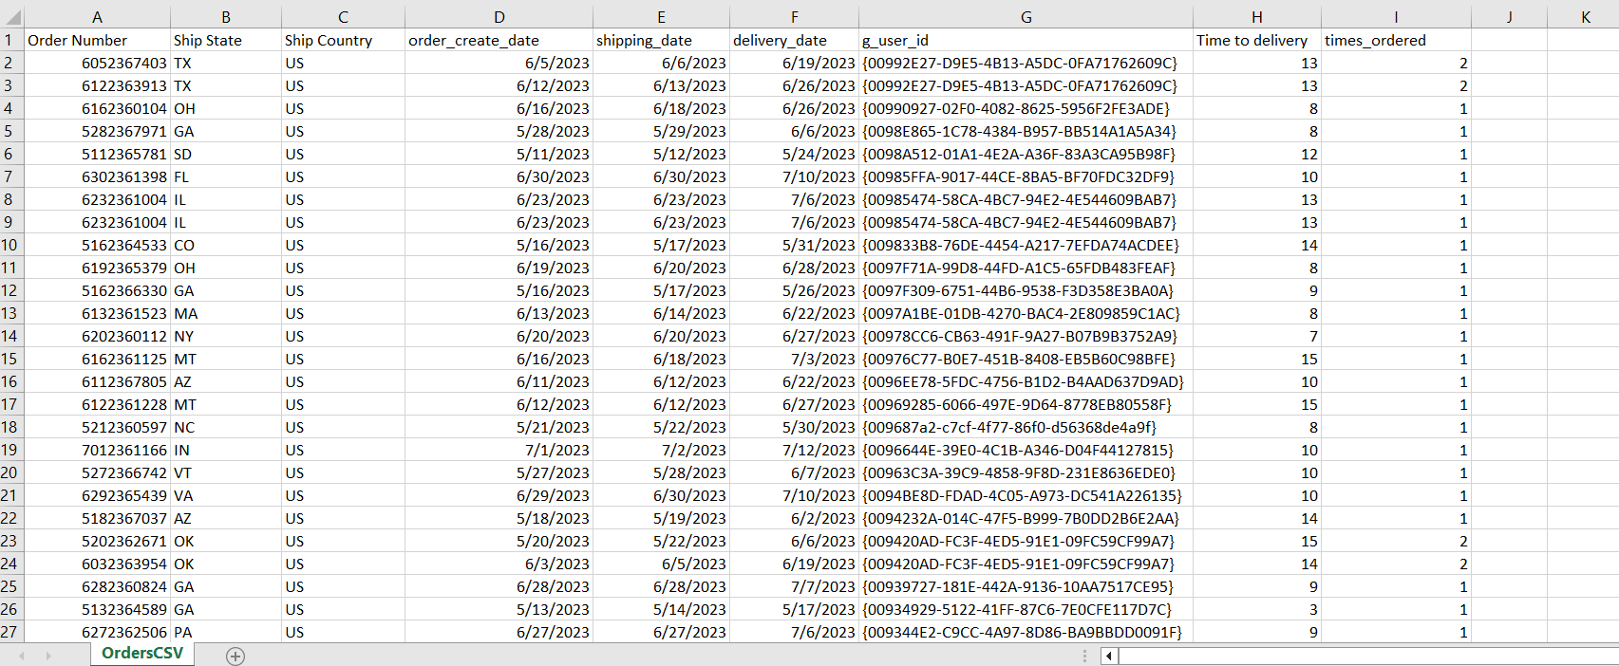
Analyzing our data sample In Excel
Total of 7,885 observations in sample
Notes:
-This is the sample we ended up with, has all the columns we need
Exported the csv from SQL, viewing with excel
Not a specific number, wanted top 10k, that was how many fit the query criteria

Slide 6
Analyzing our data sample In Excel
Goals with this data:
Create cohorts based on delivery time
Filter data to get first order of each customer – “First impression”
Then, determine percentage of people who rebought
Tried using some functions in Excel to accomplish these goals, but it wasn’t quite what we wanted…

Slide 7
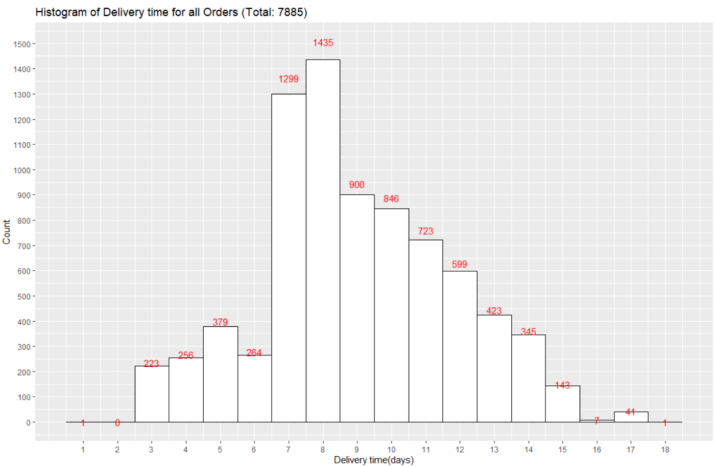

Exploration of data using R
Could I reach these goals using R?
Reading in Data table
Looking at distribution of
delivery times to determine
cohorts
Ensure all cohorts are large
Mean delivery time: 8.9
days
Notes:
Std deviation 2.81 days. Mean delivery time for customers who ordered only once: 9.02 days, rebuyers: 8.787 days, already see a trend forming

Slide 8
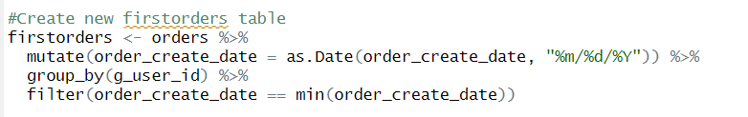
Exploration of data using R
Creating a new table with only first orders of every customer
This allows us to examine “First impressions” for each customer
Decided after talking with Michael to break up data into 6 groups (cohorts)
From less than 3 days to more than 14 days delivery time

Slide 9
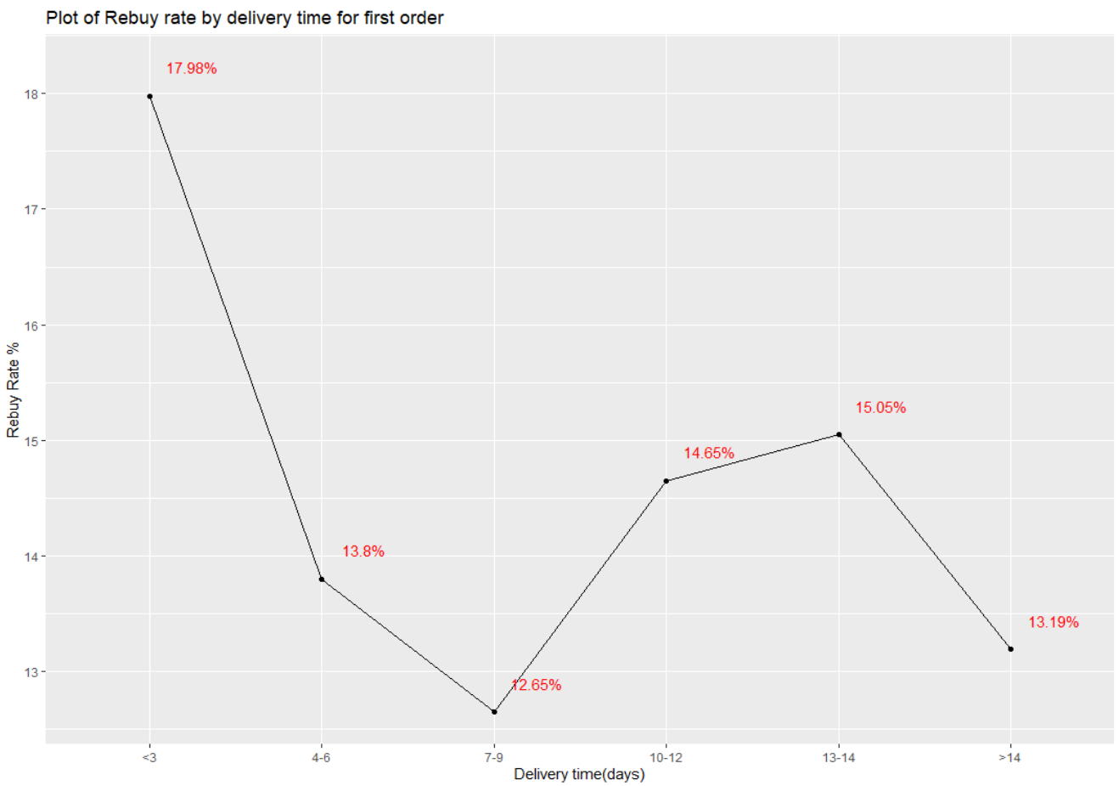
Results
Line graph of rebuy rates by length of delivery time
Shows what happened after customers first order

Slide 10
Interpretations from this graph
Based on this sample, the highest rebuy rate came from customers whose first order arrived in 3 days or less
17.98% of 178 first orders
Rebuy rate for 4-9 days drops off, with 7-9 days of delivery leading to the lowest rebuy rate, of 12.65%
Rebuy rate then slightly picks back up between 10-14 days, and drops off for orders taking over 2 weeks to 13.19%

Slide 11
Possible sources of Error
Errors in original data: Typos, query errors, missing data, etc.
Data queried based on recency, so older orders of 5-6 months weren’t prioritized
Not all data is from customers first order, just the earliest order found in the query
Doesn’t account for customers who rebought before their first order arrived*
What about customers who placed two orders back to back?
Notes:
Some customers placed two orders back to back in the same day, how many are influenced by the delivery date estimate they see on their phone?

Slide 12
Conclusions
Despite these possible errors, we can see some evidence of lower delivery times leading to higher rebuy rate
Orders taking 3 days or less to deliver led to a significantly higher rebuy rate
May indicate priority customers using expedited shipping
Orders taking over 2 weeks saw a significant drop-off in rebuy rate

Slide 13
Areas for Improvement
DHL Orders account for ~80% of total orders
Taking a larger sample or querying all orders for a sample of customers may further improve results
Results are only after first recorded purchase, what about after 2nd purchase? 3rd purchase? etc.
How can we value customers who rebought several times?
Notes:
80% still good enough to draw conclusions, just something to point out
Saw in the data one customer rebought 9 times, definitely higher value than 2 times
- Change code to weight amount of rebuys?

Slide 14
Next steps
How might other factors influence rebuy rate?
State, Region, or Country shipped to
Order Cost, Shipping cost, and Shipping type
Marketing channel and demand allocation of orders
Customer type: First time, priority, last chance
Combinations of multiple factors
Other insights from order data
How can we refine our SQL queries?
What other capabilities does R have?
How can we Incorporate tools such as ELK? DataDog?
Notes:
-Other insights besides rebuy rate

